Slide 1

Docker – an introduction
Shahbaz Chaudhary

Slide 2


Docker keeps laptop to prod environments identical
Bad environments can cause production crashes, which are very difficult to catch earlier
Python has conda, virtualenv or uv, but docker is a more general solution to freezing environments
Virtual machines simulate the whole machine (including hardware), docker simulates running a process on a linux machine – hence MUCH lighter
Sorry, it worked on my laptop Then we’ll ship your laptop to the client

Slide 3
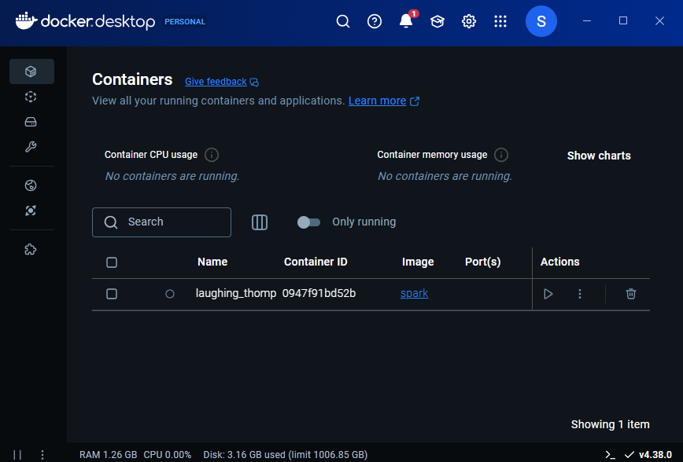
Since we have a couple of minutes Please download, install and test spark (the big data env)
Open Docker Desktop (and keep an eye on it) and the terminal app
Run docker images and docker ps –all to make sure nothing is running
Run docker pull spark and docker run -it spark /opt/spark/bin/spark-shell to run spark
actually, you can skip docker pull
Run docker images and docker ps –all to see what you downloaded and ran
How does this compare to: https://phoenixnap.com/kb/install-spark-on-ubuntu

Slide 4
Take a step back Images are the package; containers Are what is running
Docker provides an interface for two main objects: images and containers
Images are the files, executables, configurations that we build, upload, download or deploy
search | pull | list | build | remove
Containers are the actual running instances of those images, the programs, the servers and the processes
run | exec | ps

Slide 5
Images
Search Docker for an image | docker search <image name>
Download an image to local machine | docker pull <image name>
List downloaded images | docker images
Remove downloaded image | docker rmi <img>

Slide 6
Containers
Run an image | docker run --name <container_name> <image_name>
Run, but map hosts | docker run -p <host_port>:<container_port> <image_name>
 | docker run –d –restart always|unless-stopped|.. …
Start or stop a container | docker start|stop <container name|id>
Which containers are running (or have run) | docker ps --all
“ssh” into the container | docker exec -it <container_name> sh

Slide 7
Lectures/dockerize_python_app/100_minimal_27 Build your own docker image (for deployment)
app.py
print "Hi from many years ago :)"
# Use a small base image .... dangerously old!
FROM python:2.7-slim
# Set the working directory
WORKDIR /app
# Copy the application code
COPY app.py .
# Run the application
CMD ["python", "app.py"]
Dockerfile
Commands to run
docker build -t hello_app .
docker run hello_app

Slide 8
Docker creates “layers” and caches them Dockerfile
Base image, starting point
“Current” directory, no need to ‘cd’
Copy code from local machine to docker
Run this command when docker “runs”
# Use a small base image .... dangerously old!
FROM python:2.7-slim
# Set the working directory
WORKDIR /app
# Copy the application code
COPY app.py .
# Run the application
CMD ["python", "app.py"]

Slide 9
Lectures/dockerize_python_app/110_minimal_server Build your own docker image (for deployment)
app.py
Dockerfile
requirements.txt
from fastapi import FastAPI
app = FastAPI()
@app.get("/")
def read_root():
return {"message":
"Hello, FastAPI in Docker!"}
# Use the official Python image as a base
FROM python:3.11-slim
# Set the working directory
WORKDIR /app
# Copy the requirements file and install dependencies
COPY requirements.txt .
RUN pip install --no-cache-dir -r requirements.txt
# Copy the application code
COPY . .
# Expose the FastAPI default port
EXPOSE 8000
# Command to run the application
CMD ["fastapi", "run", "app.py", "--host", "0.0.0.0", "--port", "8000"]
fastapi[standard]
Commands to run
docker build -t minimal_server .
docker run -d -p 8000:8000 minimal_server
curl http://localhost:8000

Slide 10
Use “Docker run” and its many variations
Docker exec to connect to a running container

Slide 11
Run a container, exit when the command exits
docker run hello_app

Slide 12
Start a container, connect to it interactively
Connect a fake ”console” to the container
docker run –it hello_app bash
Run container interactively, accept keyboard input, etc.
Run this command inside the container.
As if you ssh into a machine
If the container is already running
docker exec –it hello_app bash

Slide 13

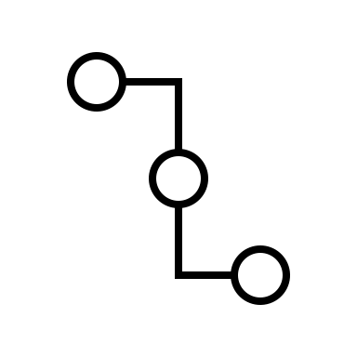

Start a container, run a service inside it
Map port inside container to a port on the host machine
docker run –d –p 8000:8000 minimal_server
Run container in “detached” mode, so you don’t have to keep the terminal window open
Run this command inside the container.
As if you ssh into a machine

Slide 14
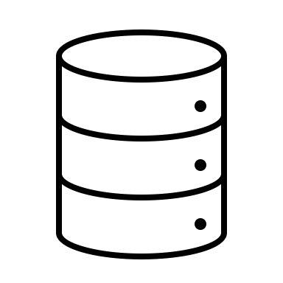
Share a folder between host and container
docker run –d –v /host/path:/container/path hello_app
The volume flag shares a folder between the host and the container

Slide 15

Start docker, even on reboot
docker run –d –restart always hello_app
Even if the computer shuts down, when it starts back up, bring up docker container

Slide 16
“Push” your image to Docker Hub
And “pull” as well

Slide 17
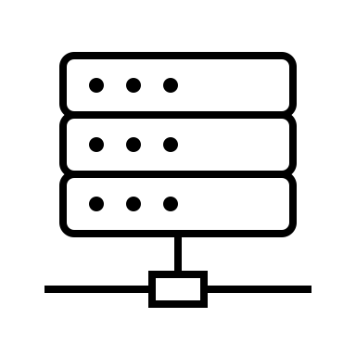
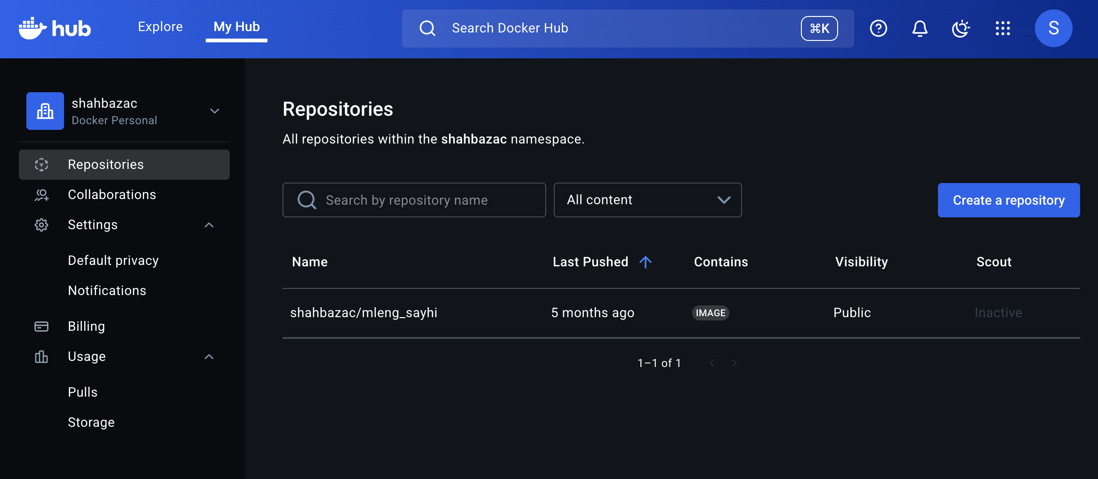
Hub.docker.com is one of many public docker repos
docker push
docker pull

Slide 18
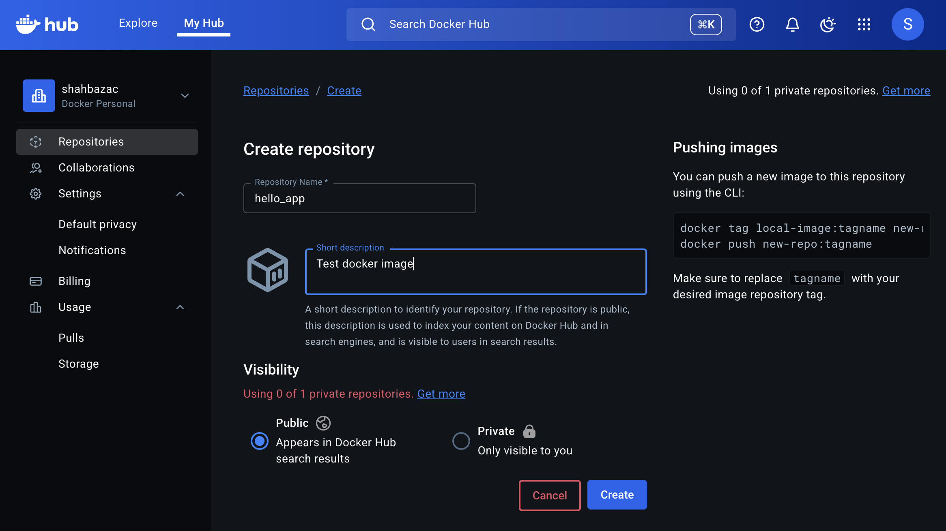
First, create a repository
Notice the user name

Slide 19
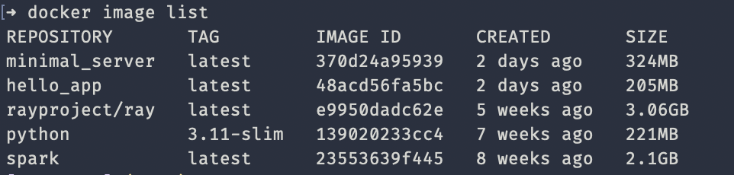
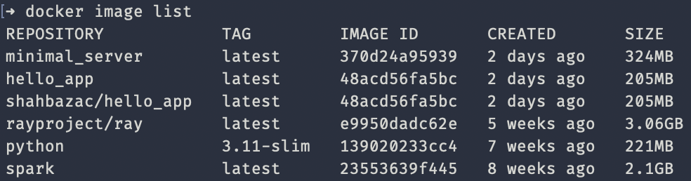
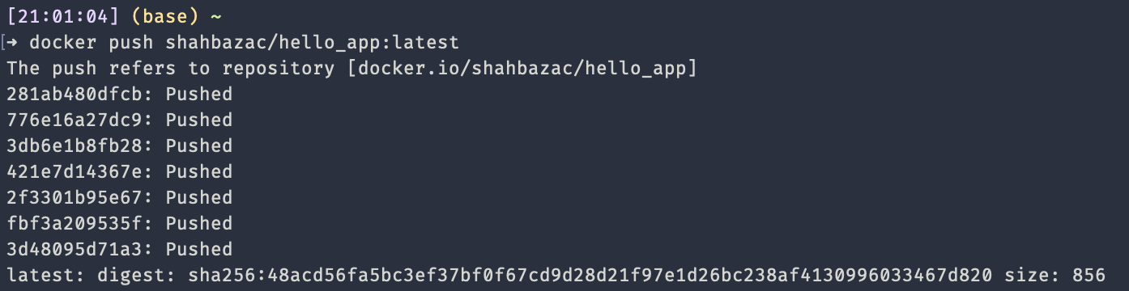
Tag your image
Notice the user name

Slide 20
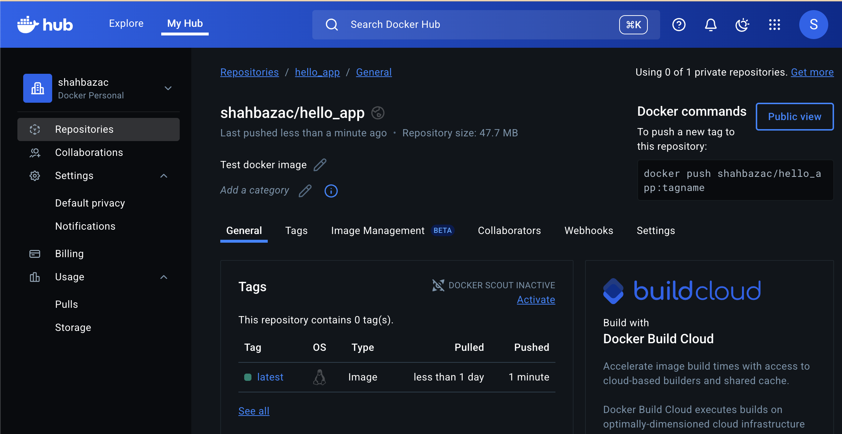
Your image is now available for others to “pull”

Slide 21
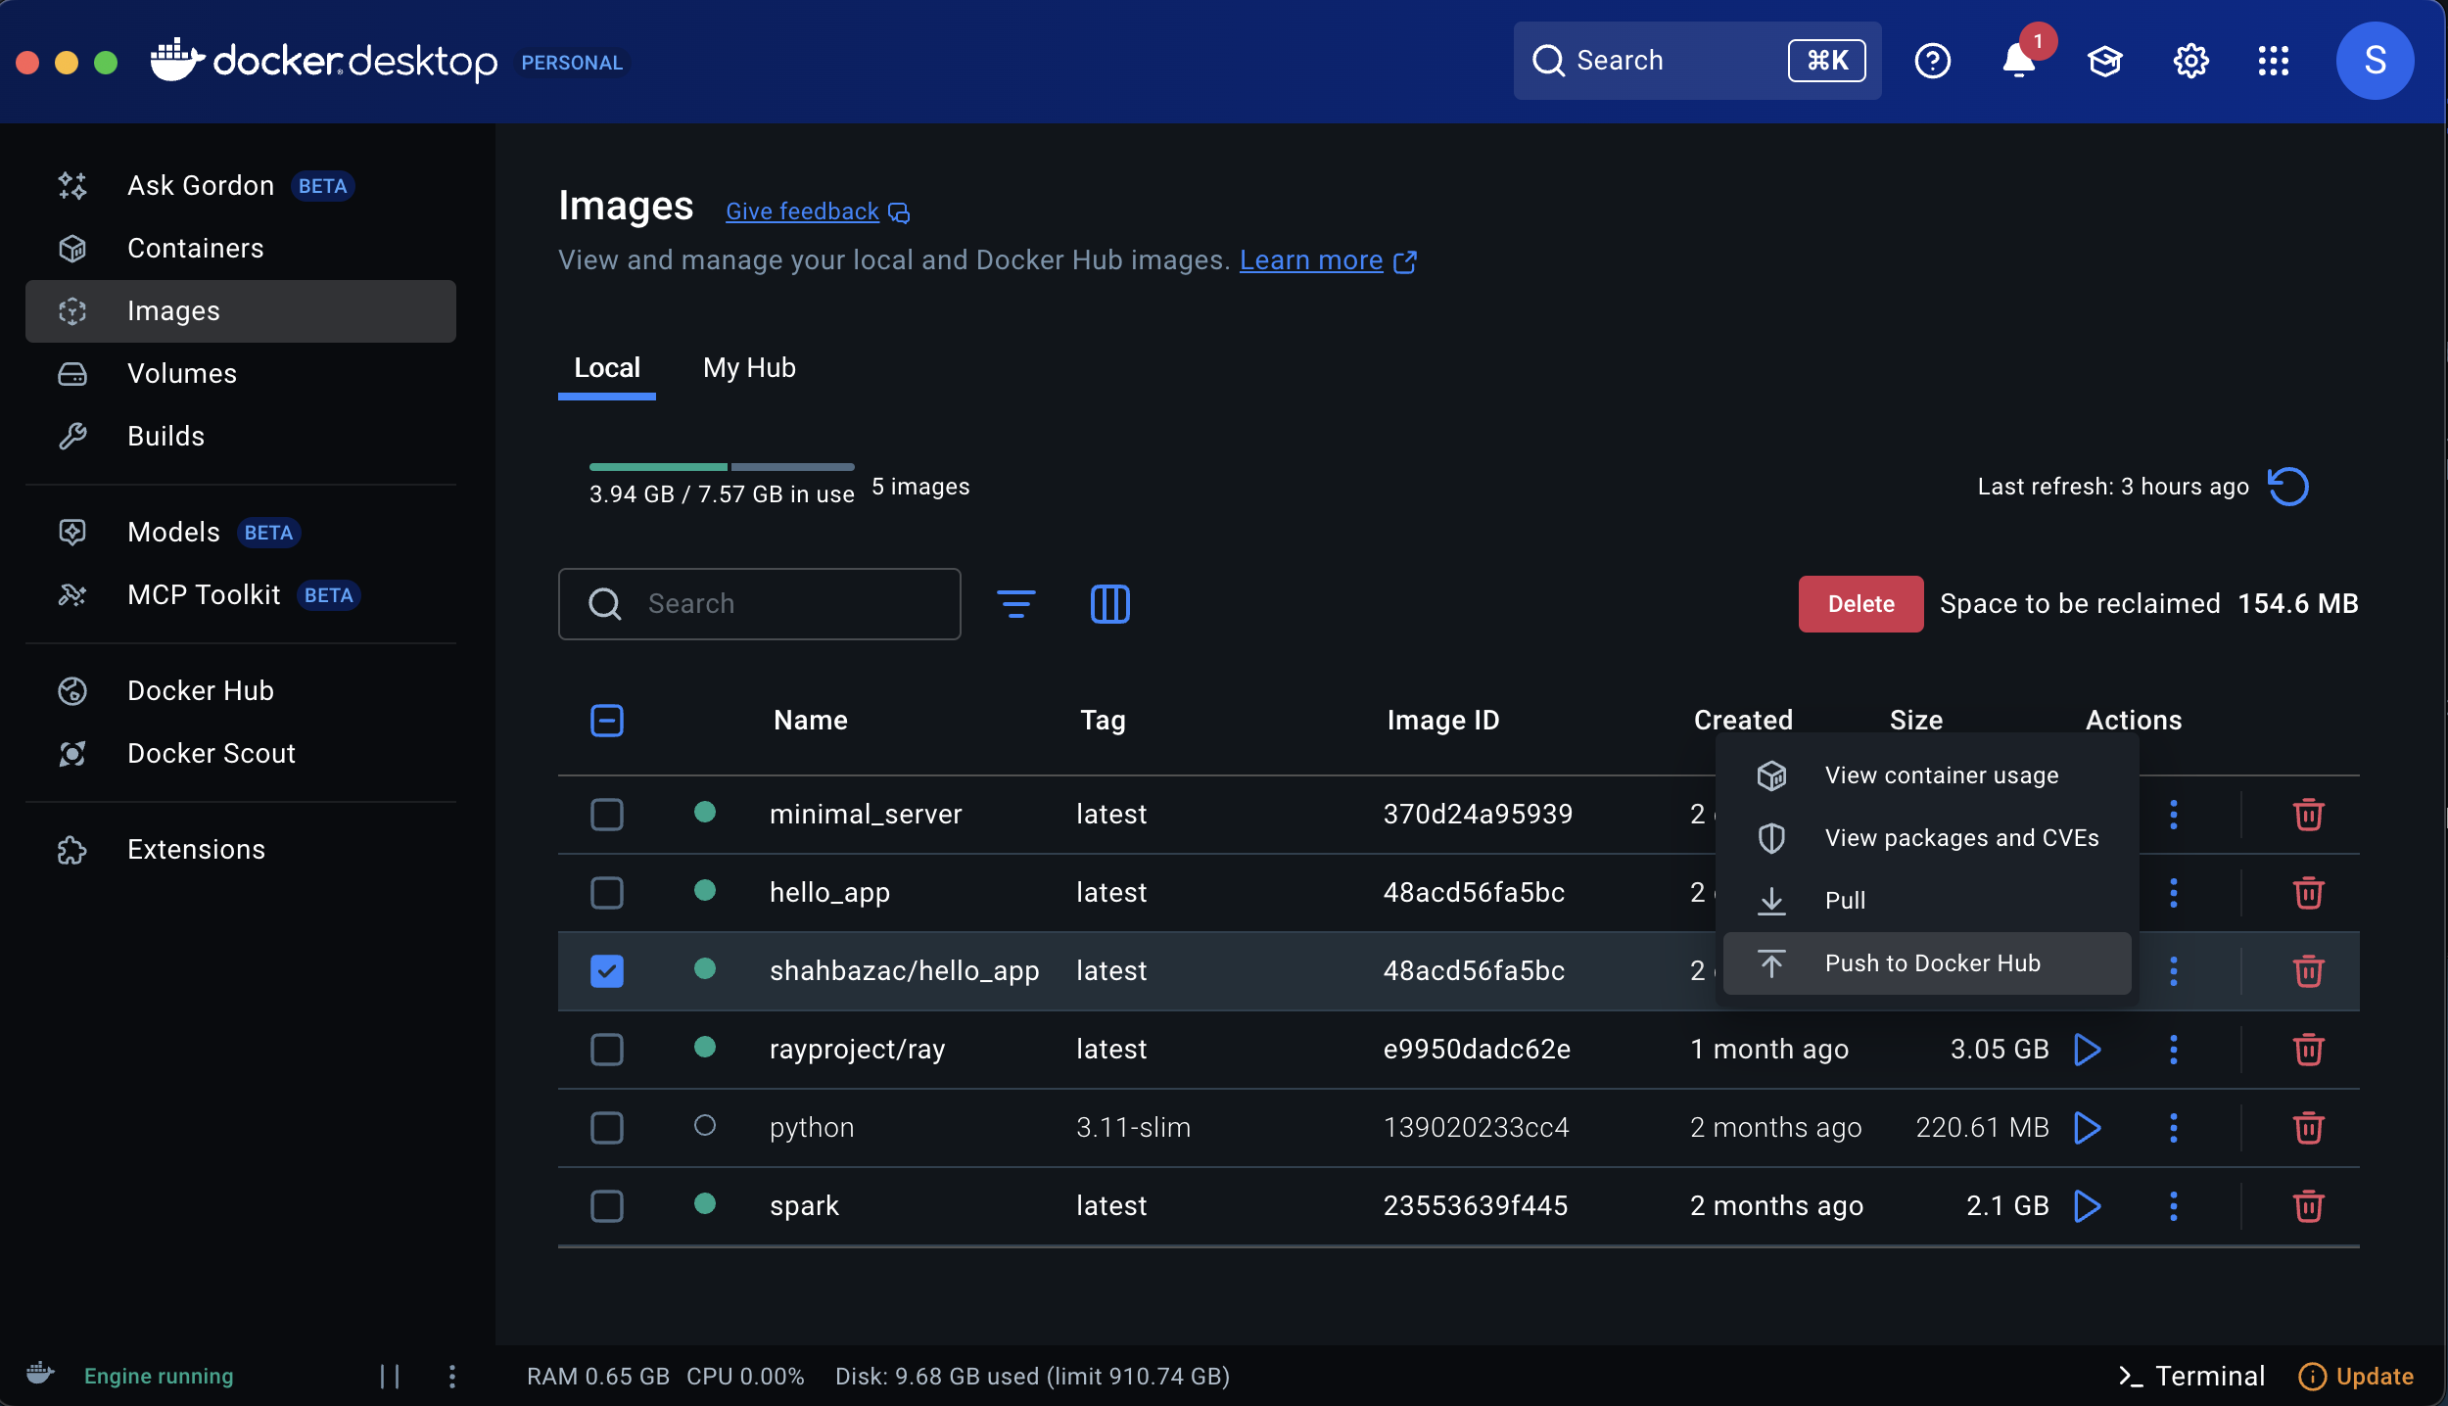
You can also use docker desktop to push

Slide 22
“Deploy” docker to a remote server

Slide 23




“Deploy” docker container to a remote machine via ssh
docker pull image_name:latest
docker stop image_name
docker rm image_name
docker run –d –restart always –name image_name
Either ssh into the remote machine and run these commands or execute them as a remote script, executed locally:
ssh user@remote_host << ‘EOF’
docker pull image_name:latest
docker stop image_name
docker rm image_name
docker run –d –restart always –name image_name
EOF

Slide 24
Deploy docker to a remote machine via github actions
BUILD
See this for an up-to-date template
name: Build and Push Docker Image
# "best practice", from https://docs.docker.com/guides/gha/
on:
push:
branches:
- prod
jobs:
build:
runs-on: ubuntu-latest
steps:
- name: Get Git commit timestamps
run: echo "TIMESTAMP=$(date +%Y%m%d%H%M%S)" >> $GITHUB_ENV
- name: Checkout
uses: actions/checkout@v4
- name: Extract Docker image metadata
id: meta
uses: docker/metadata-action@v5
with:
images: ${{ vars.DOCKER_USERNAME }}/mleng_sayhi
- name: Log in to Docker Hub
uses: docker/login-action@v3
with:
username: ${{ vars.DOCKER_USERNAME }}
password: ${{ vars.DOCKER_PASSWORD }}
- name: Set up Docker Buildx
uses: docker/setup-buildx-action@v3
- name: Build and push Docker image
uses: docker/build-push-action@v6
with:
push: ${{ github.event_name != 'pull_request' }}
tags: |
${{ vars.DOCKER_USERNAME }}/mleng_sayhi:${{ env.TIMESTAMP }}
${{ vars.DOCKER_USERNAME }}/mleng_sayhi:latest
annotations: ${{ steps.meta.outputs.annotations }}
provenance: true
sbom: true
When code is pushed to the prod branch, execute the following steps
Log in to docker hub
…in an Ubuntu virtual machine
Get the current date and time
Check out the github repository
Build docker image and push to docker hub
“GitHub Action to extract metadata (tags, labels) from Git reference and GitHub events for Docker” (??) from Docker

Slide 25
Deploy docker to a remote machine via github actions
name: Deploy Docker Image to Server
on:
workflow_run:
# This GitHub Action depends on another, which package up docker and pushes it to a docker repo
workflows: ["Build and Push Docker Image"]
types:
- completed
jobs:
deploy:
runs-on: ubuntu-latest
# If the docker build went ok and the image was pushed to the docker repo, then deploy it to the server
if: ${{ github.event.workflow_run.conclusion == 'success' }}
steps:
- name: Deploy to Linux server
uses: appleboy/ssh-action@v1.0.3
with:
host: ${{ secrets.SERVER_HOST }}
username: ${{ secrets.SERVER_USER }}
key: ${{ secrets.SERVER_SSH_KEY }}
script: |
docker pull ${{ vars.DOCKER_USERNAME }}/mleng_sayhi:latest
docker stop ${{ vars.DOCKER_USERNAME }}/mleng_sayhi || true
docker rm ${{ vars.DOCKER_USERNAME }}/mleng_sayhi || true
docker run -d --name ${{ vars.DOCKER_USERNAME }}/mleng_sayhi
-v /opt/assignment_outputs:/app/data ${{ vars.DOCKER_USERNAME }}/mleng_sayhi:latest
ssh into the remote server,
update the docker image,
stop the previous one,
remove the previous one
and run the latest

Slide 26
Deploy docker to a remote machine via github actions

Slide 27
Using and abusing Docker
Docker is based on a set of linux technologies which allow the operating system to isolate processes and make them believe they are the only ones running.
Compare this with normal linux accounts where you can see that there are other user on /home and other processes running via ps -ef
When we run Docker on Windows or Mac, linux is being virtualized first, then docker is being run inside it!
Docker environment should be set up entirely via Dockerfile. Do NOT execute commands on the shell to update the environment. That defeats the purpose of docker. I have seen this in online tutorials
But you can enter the shell, as if you were ssh into a remote machine: docker exec -it <container_name> sh

Slide 28
On to kubernetes
Run docker across a cluster

Slide 29
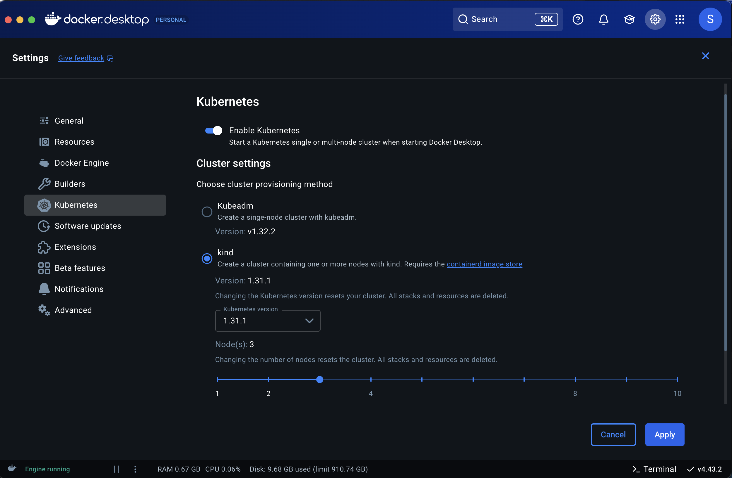
Enable kubernetes

